Slide 1

Project 1
UM BC CLASS
Food Analytics

Slide 2

Food Popularity Data Analytics
Comparison of different general food topics by region
Visualize various data points to give clear insights
Historical information over the last five years and growth among categories

Slide 3
Aims of Project
Many use cases for the data analytics:
Farmers
Restauranteur
Marketing/Advertising
Caterers

Slide 4
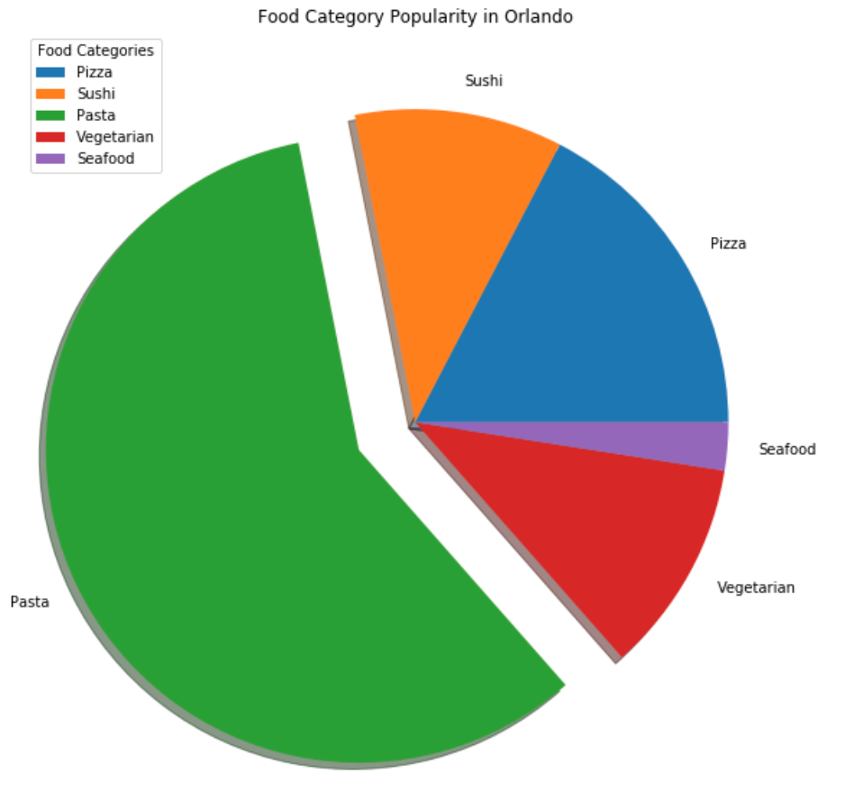
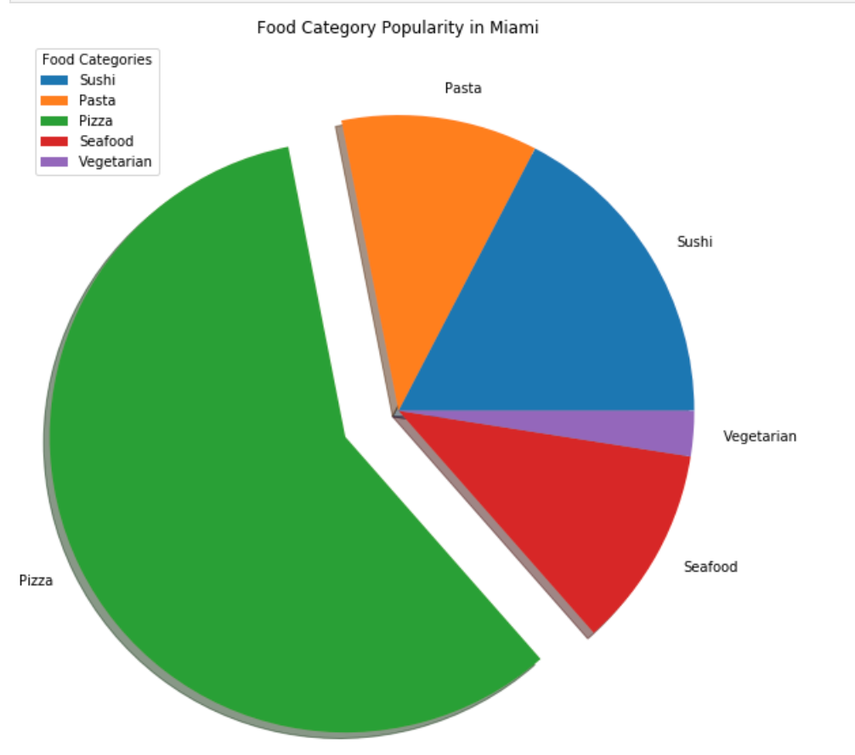
Comparison of Food By Region

Slide 5
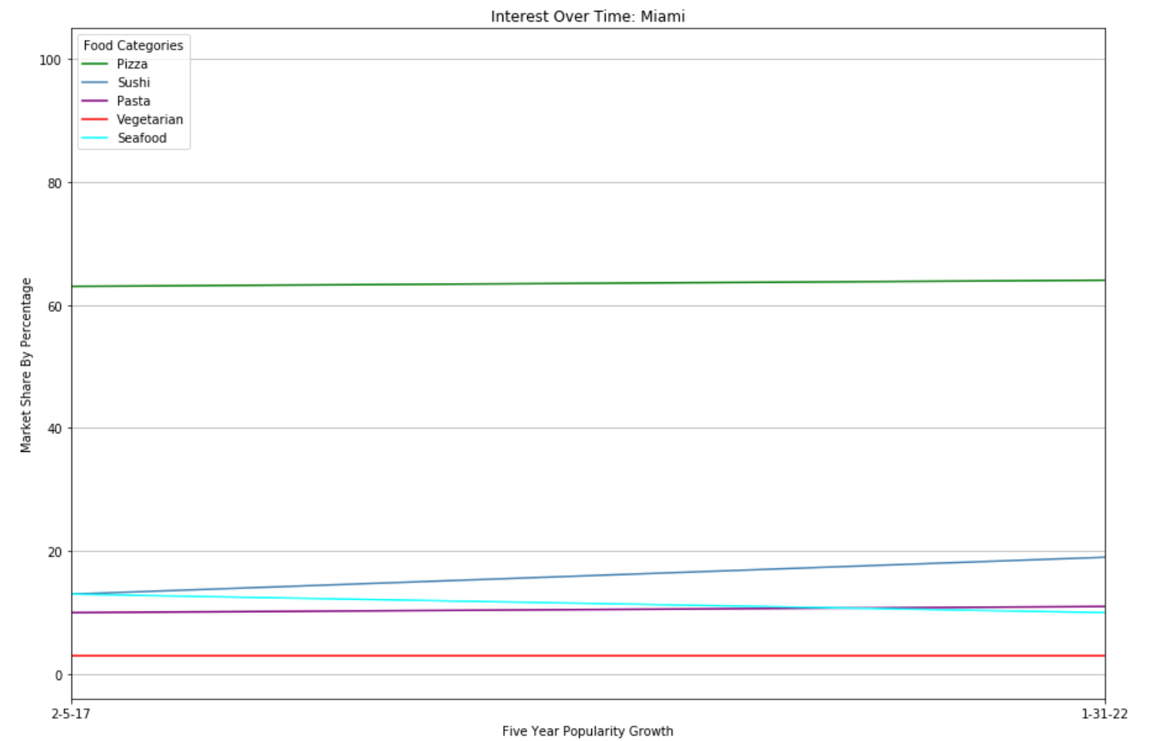
Comparison of Interest Over Time

Slide 6
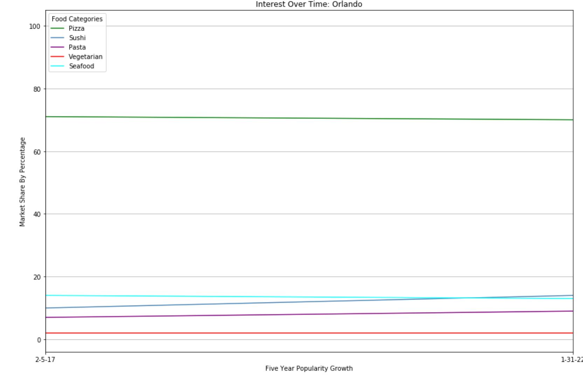
Comparison of Interest Over Time

Slide 7
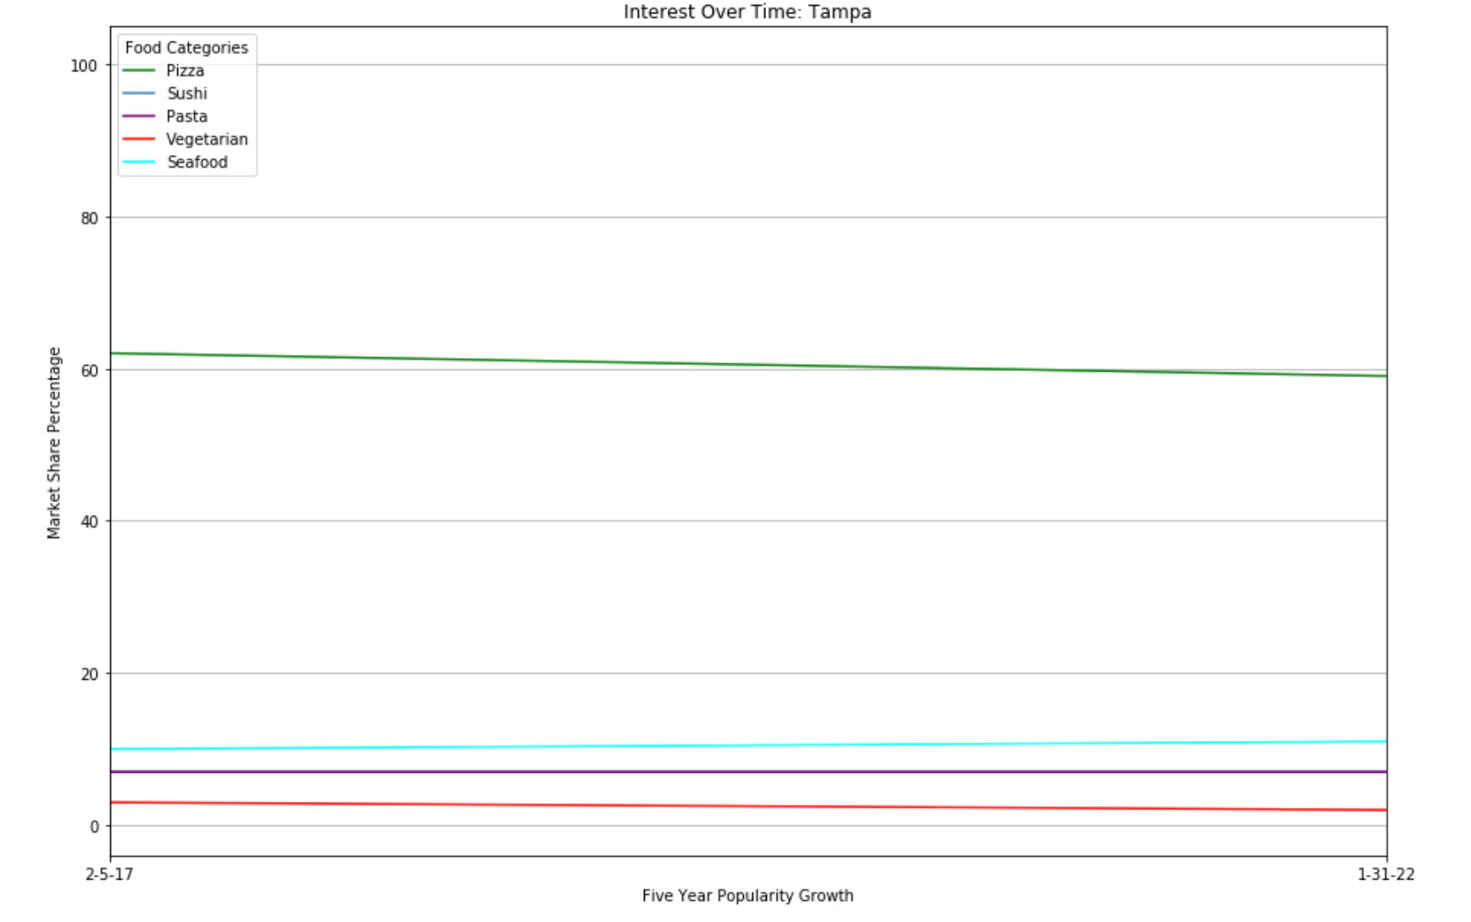
Comparison of Interest Over Time

Slide 8
Insights on Over Time and Comparisons
Pizza in the dominant food category with little to no growth in the last five years in terms of popularity
Tampa serves as an outlier for this as pizza has lost popularity but still is the dominant food category
Sushi experienced the biggest change in growth out of all of the food categories except for in the region of Tampa where the sushi category stayed flat
Vegetarian and Sushi grew parallel with each other being a possible change in younger demographics preferences
Another surprise is that seafood was flat

Slide 9
Dish Comparison
We looked into each food category and picked specific popular dishes to see food preferences within each category
Better understanding of consumer base and what products to source

Slide 10
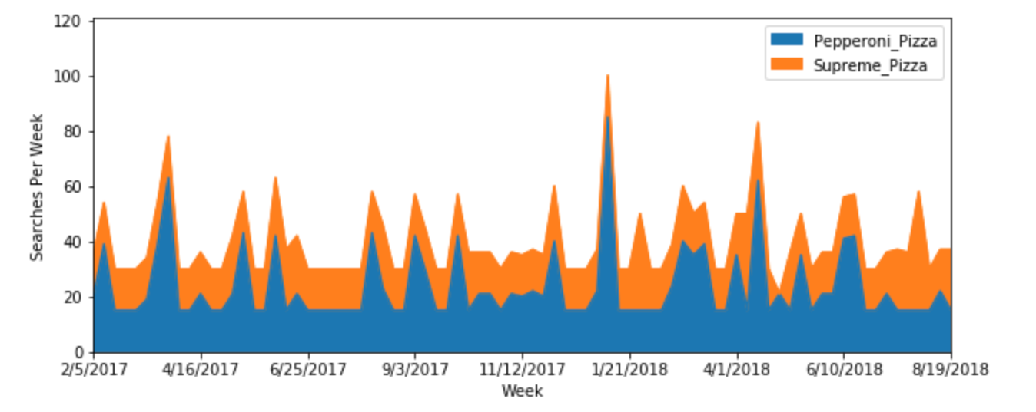
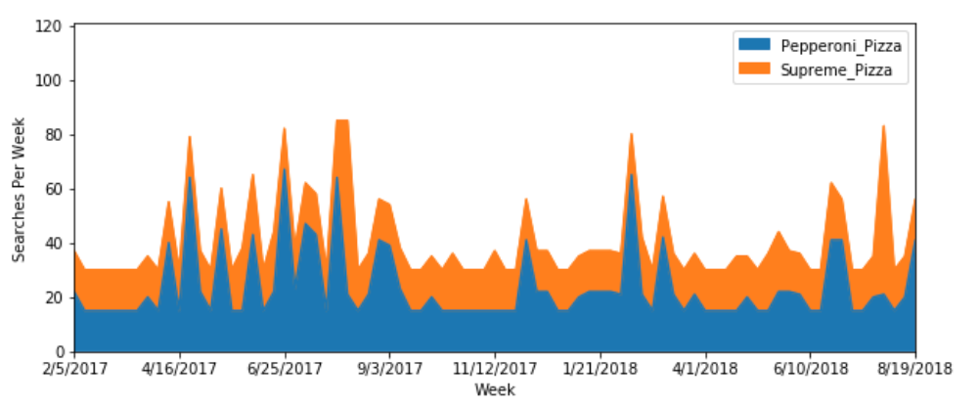
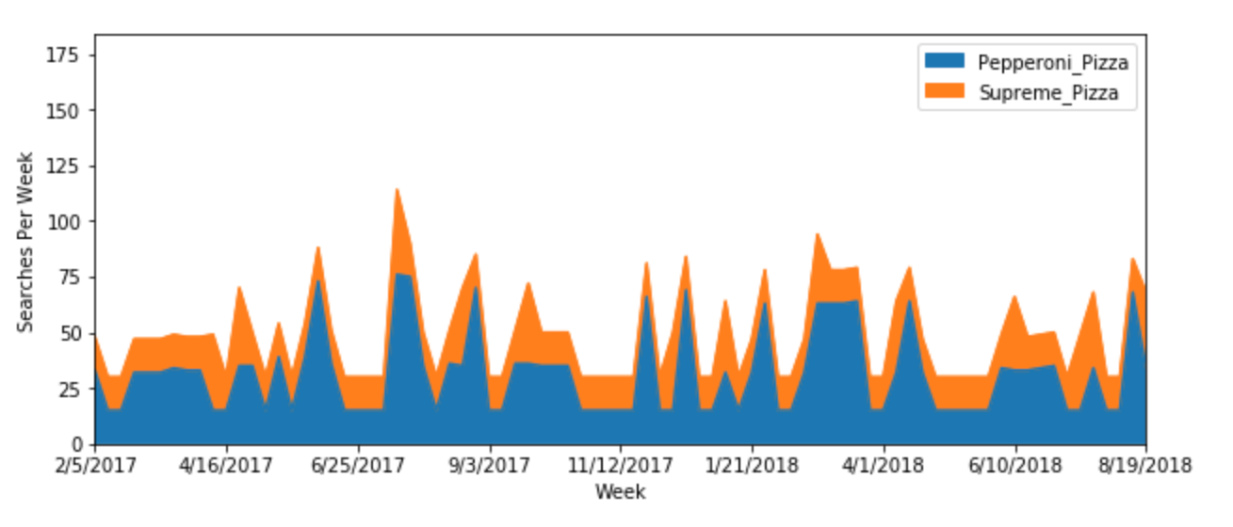
Dish Comparison: Pepperoni Pizza Vs. Supreme
Miami
Supreme proved historically to be more popular between the regions
The difference becomes narrower as you look at Tampa
This was found to be surprising as pepperoni pizza is known to be a classic type of pizza
The state of Florida could serve as an outlier compared to other states
Orlando
Tampa

Slide 11
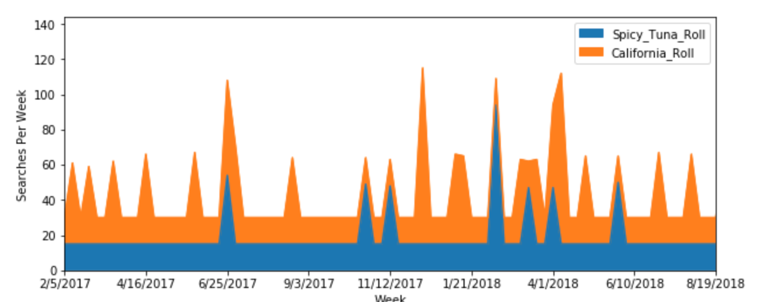
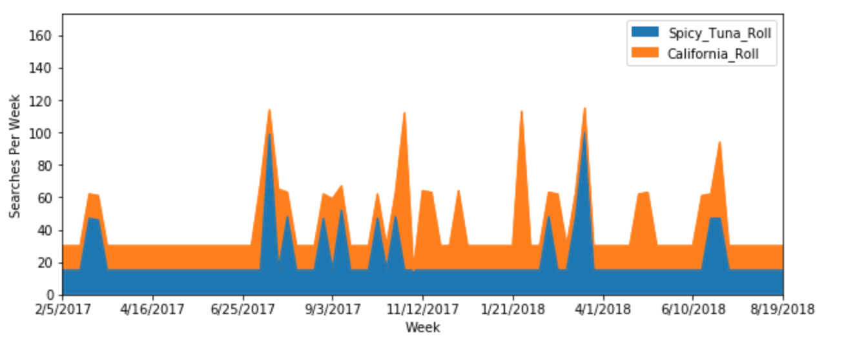
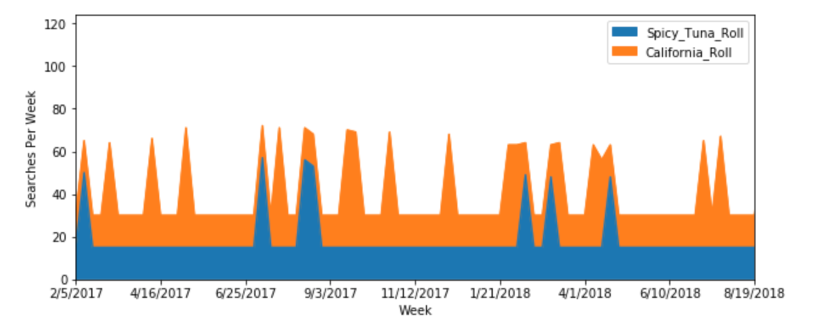
Dish Comparison: Spicy Tuna Roll vs California Roll
Miami
California roll proved to be the more popular option
This could be due to a preference for imitation crab over tuna or preferences in terms of spicy vs non-spicy dishes
Sushi appears to have dramatic spikes and then flatlines
The time periods in which sushi dishes appear to be the most desired is around Valentine's day and during the summer
Orlando
Tampa

Slide 12
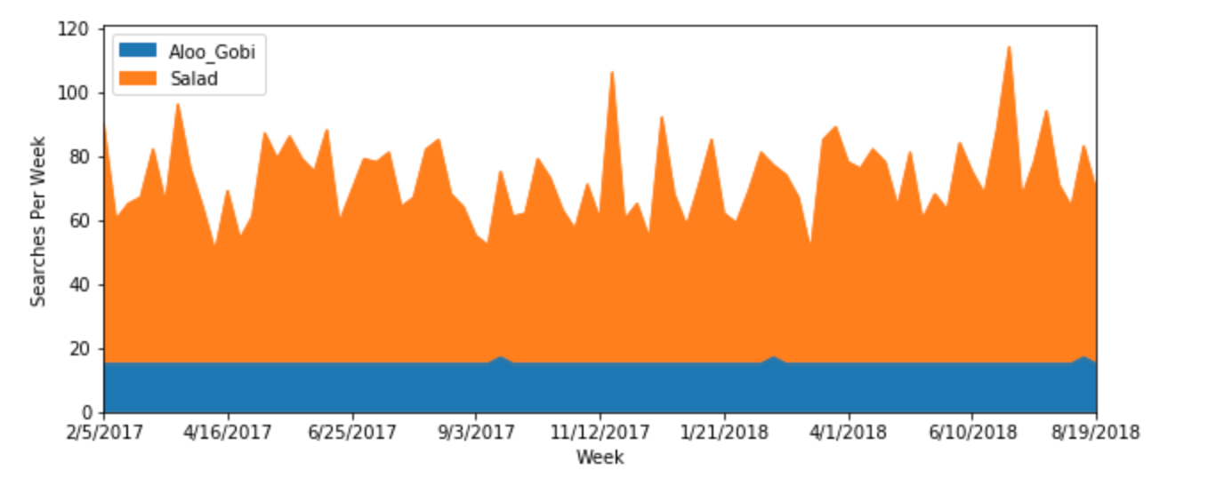
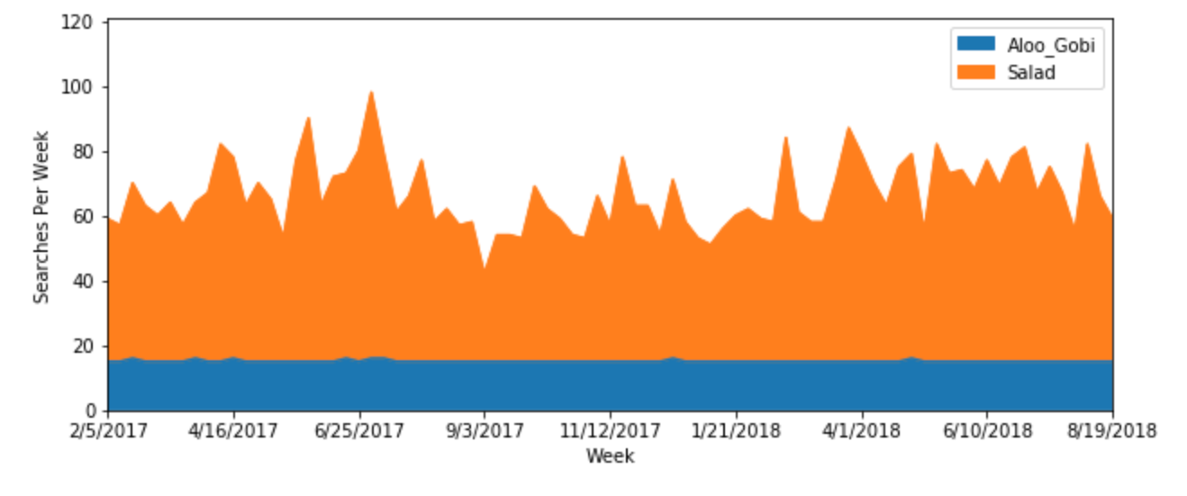
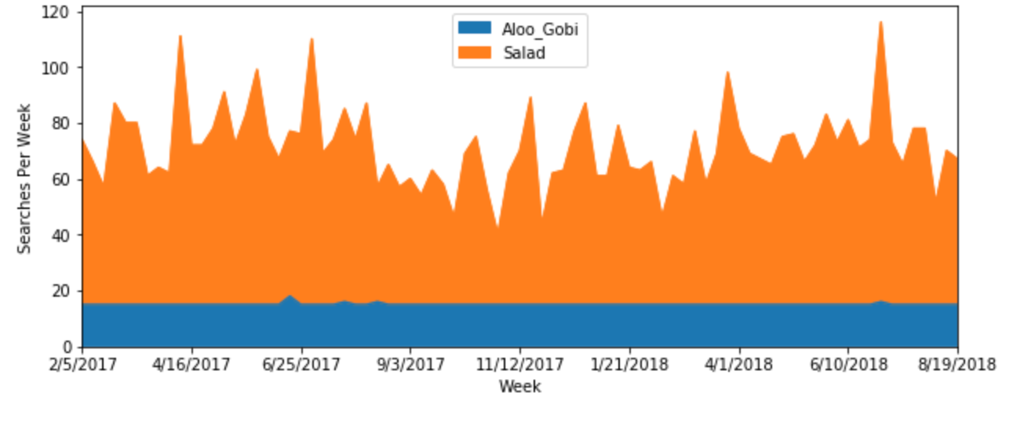
Dish Comparison: Salad vs. Aloo Gobi
Miami
Orlando
The difference in popularity wasn’t surprising
It is interesting in how salad interest would increase as the summer approached and during the summer
Another interesting detail was how consistent the interest in Indian dishes have been
Tampa

Slide 13
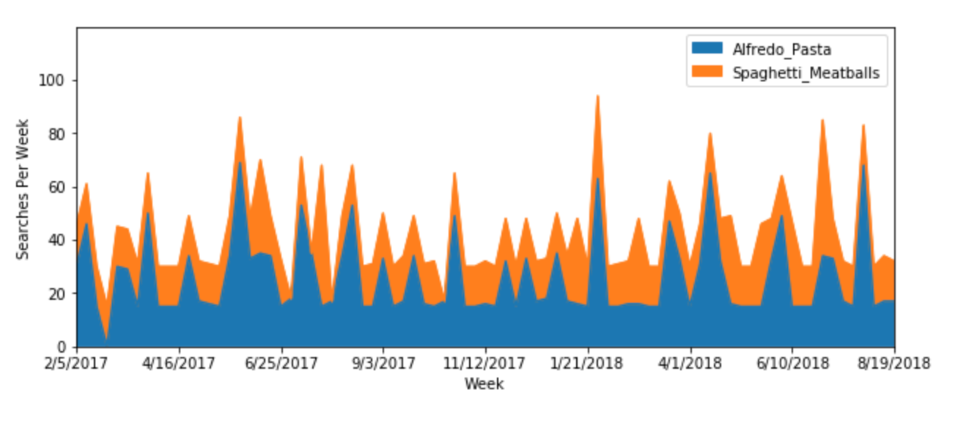
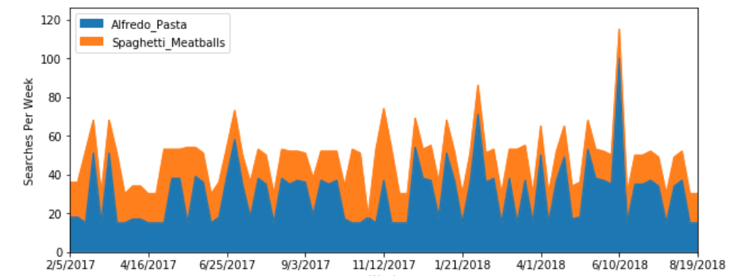
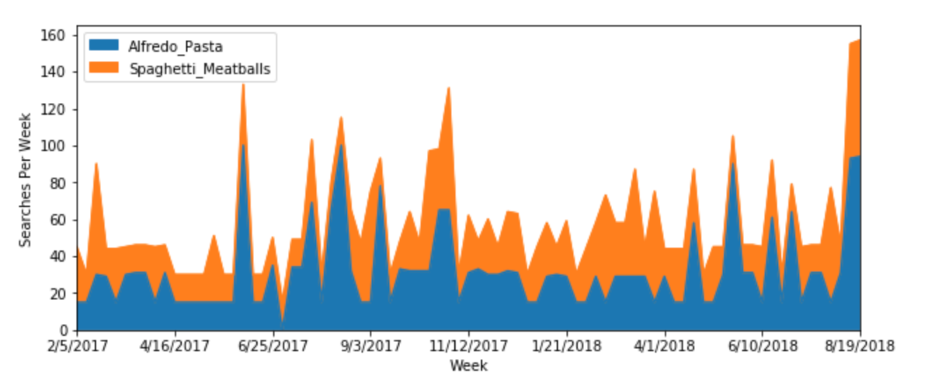
Dish Comparison: Alfredo Pasta vs. Spaghetti and Meatballs
Miami
To our surprise, spaghetti with meatballs proved to be more popular than alfredo pasta. Both are staples in Italian cuisine
In the three regions, interest in pasta consistently would spike and dip but never flatline for long periods of time
Orlando
Tampa

Slide 14
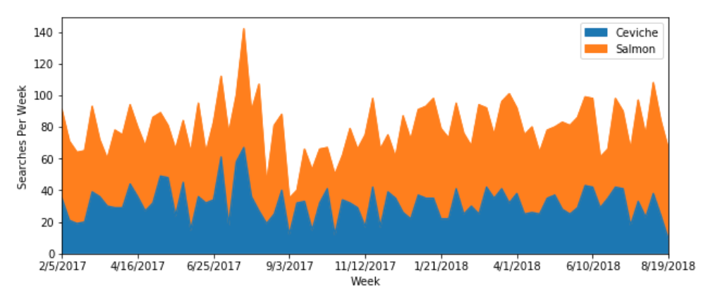
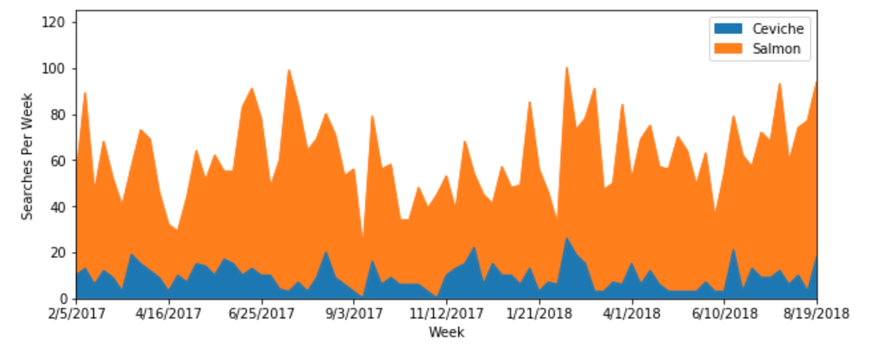
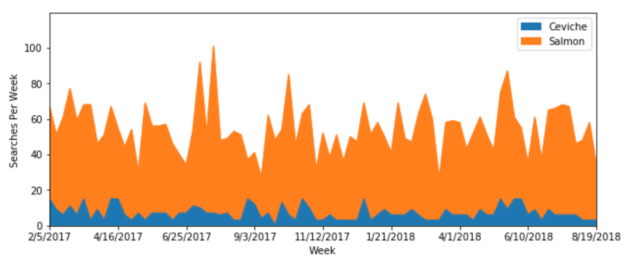
Dish Comparison: Ceviche vs. Salmon
Miami
Salmon proved to be the most popular by a wide margin
The difference in popularity between the two dishes in Miami is not nearly as wide
This could be due to cultural differences
Orlando
Tampa

Slide 15
Consumer Habits

Slide 16
Contributors
Eduardo Quin
Anthony Segovia
Clifford Charles

